Slide 1
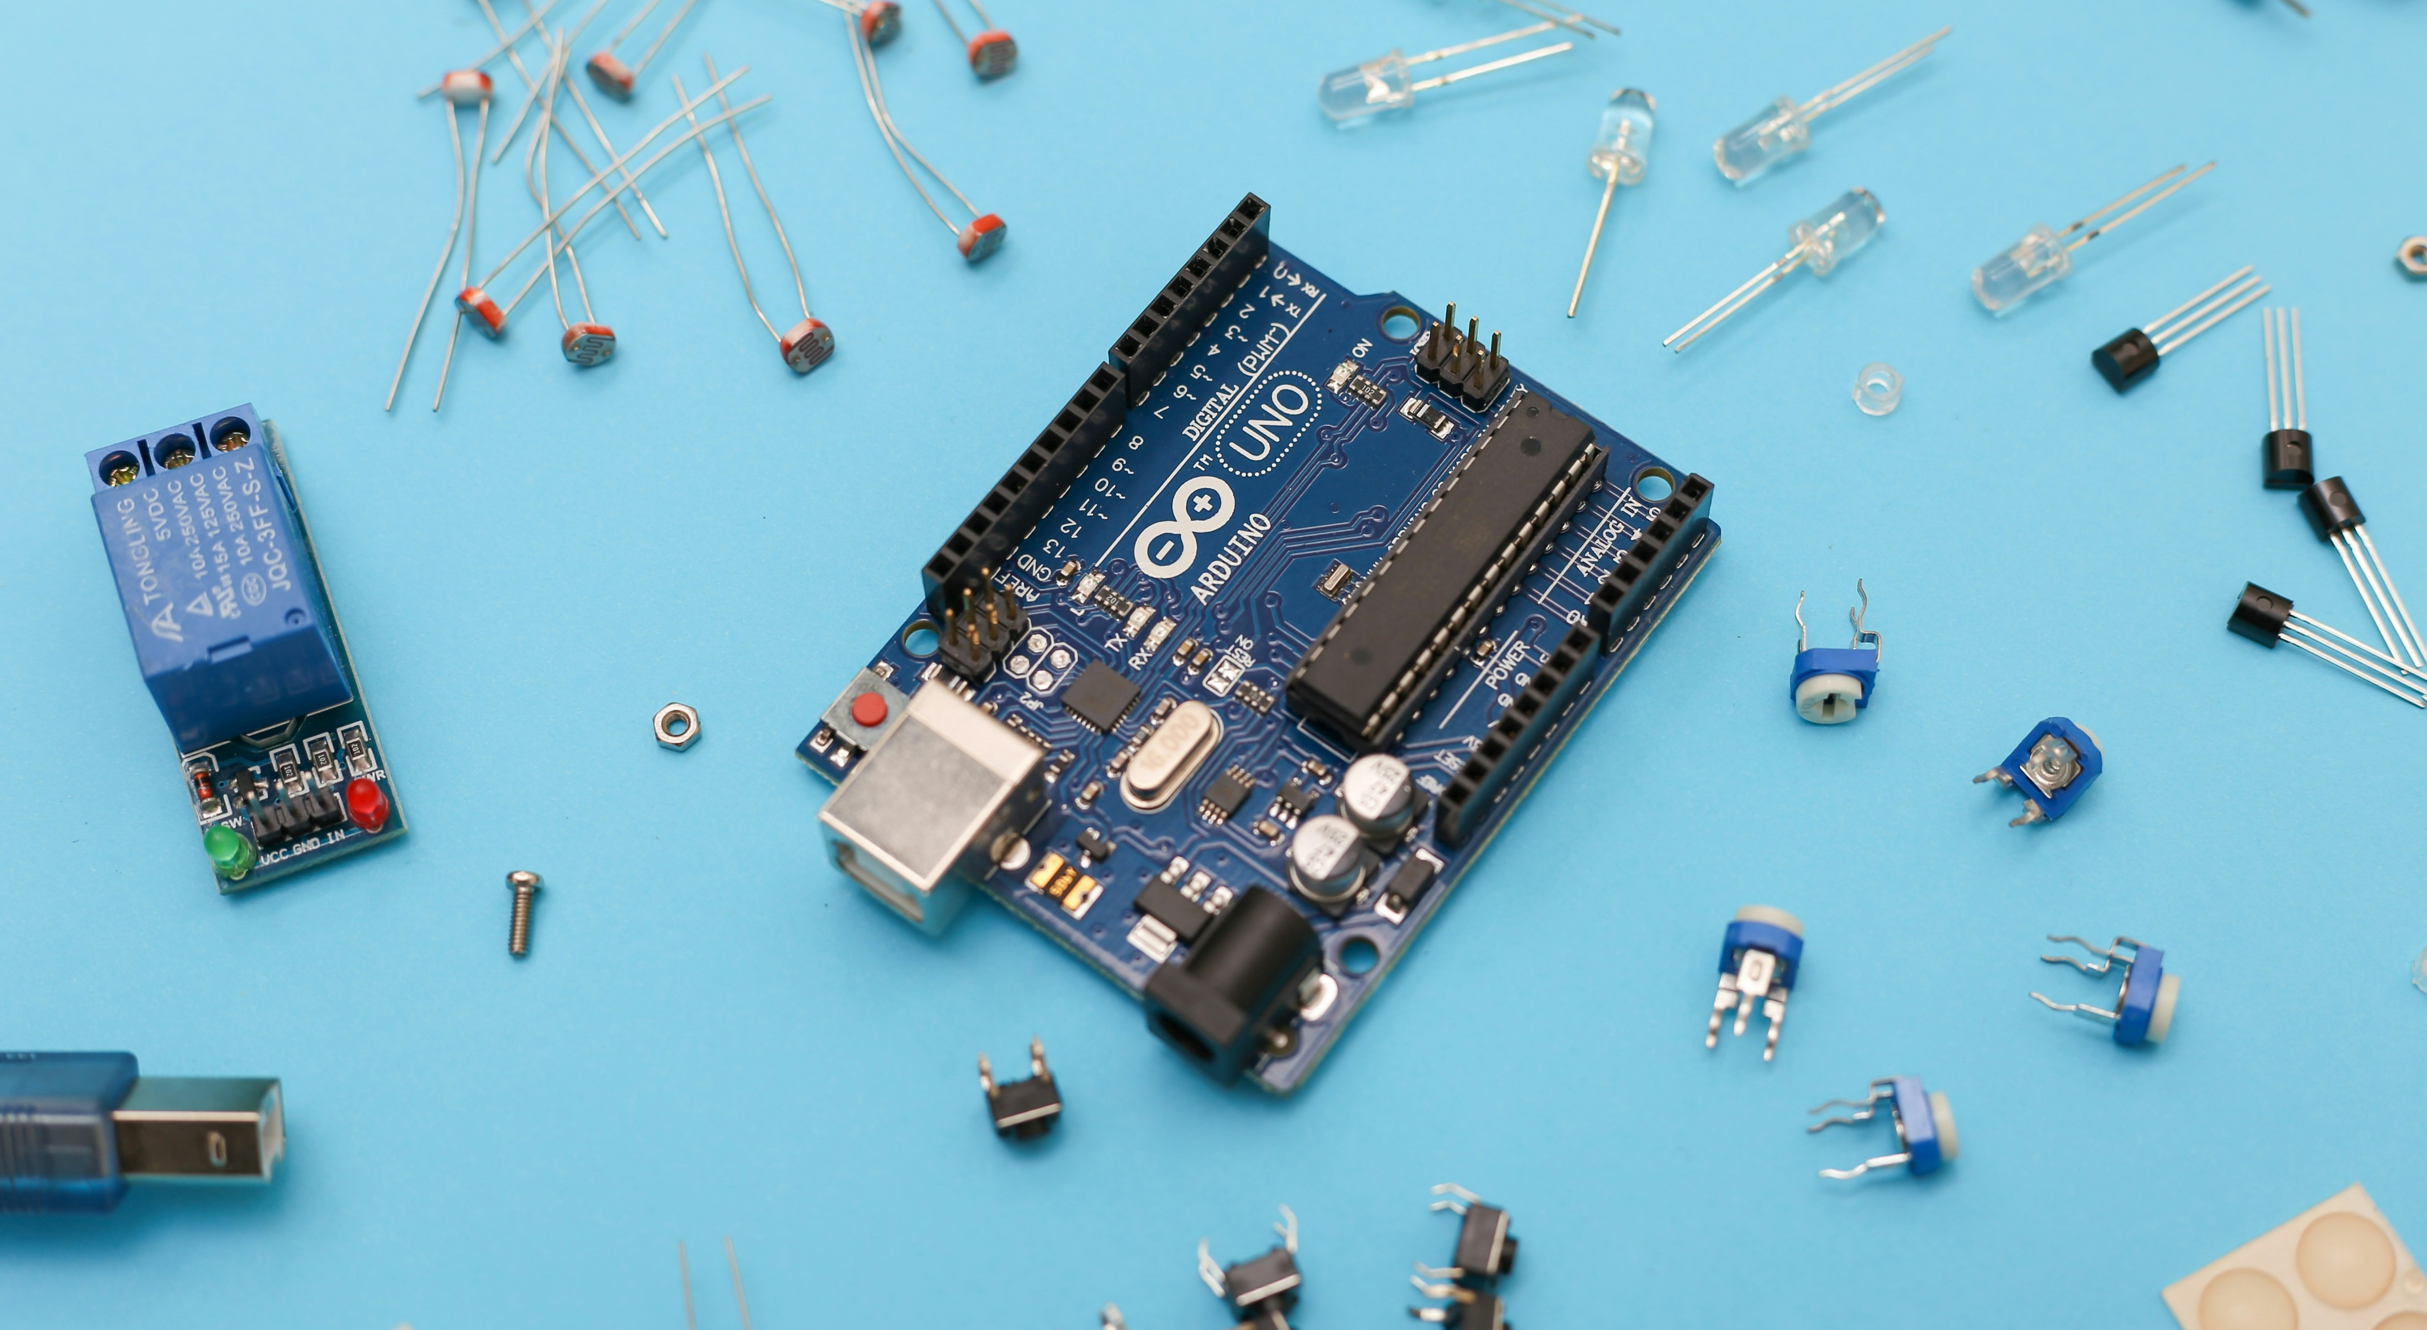

Lab Inventory Management API
Case Study : Intelligent Systems
Allan Johns
Amritesh Vadakkedath Babu
Anaz Nizarudeen Raseena Beevi
Asin Sona Thomas

Slide 2
Quick Recap
Objective
To enhance efficiency and accuracy in inventory tracking by implementing a robust Flask-based application.
Today’s focus
Progress update with a detailed discussion on API endpoints and their implementation.

Slide 3
Progress Overview
Completed Milestones:
Ongoing Tasks:
Next Steps:
Developed core routes for login, inventory management, and item updates.
HTML templates integrated with Flask routes for a seamless user experience.
Basic authentication implemented using.
CRUD operations for managing inventory items.
Refining the UI for better usability.
Preparing Docker container for deployment.
Deployment to the university server via Docker.

Slide 4
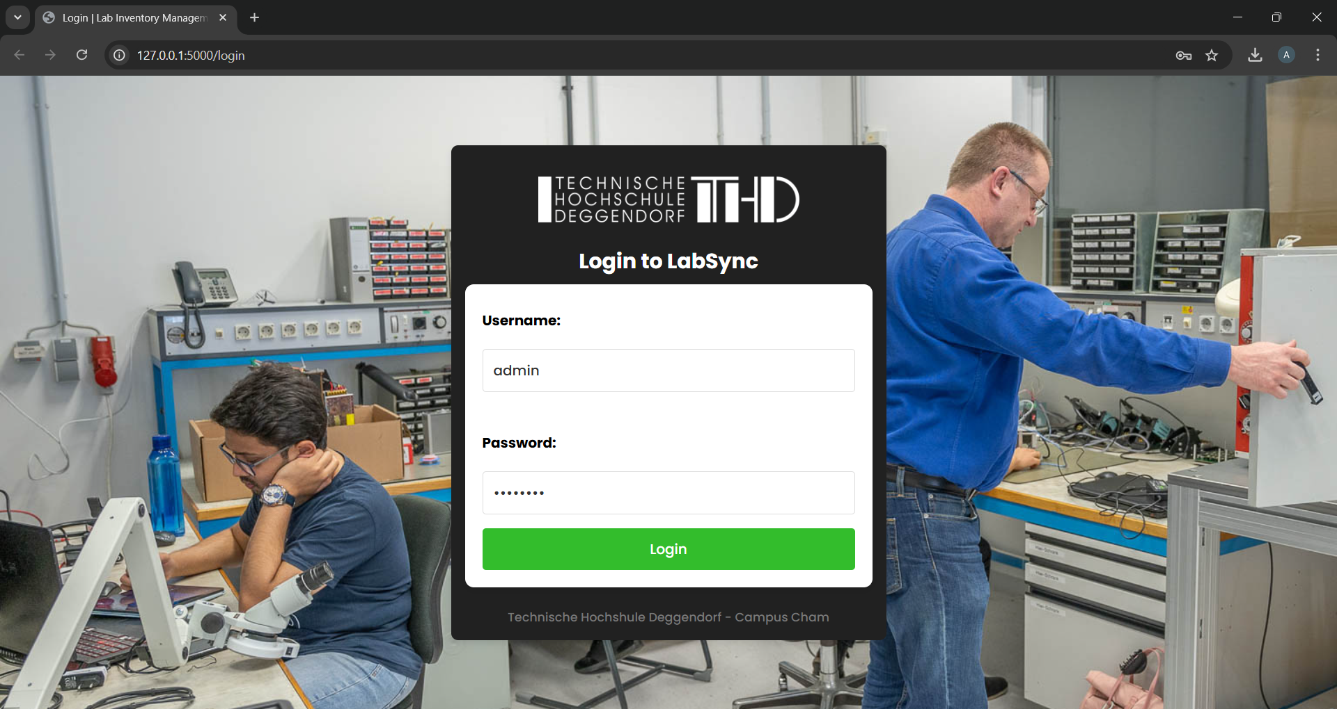
Key Routes Overview 1. /login
User Authentication
Accepts a username/password (hardcoded users for simplicity) and logs the user in.
Validates credentials and starts a session using Flask-login.

Slide 5
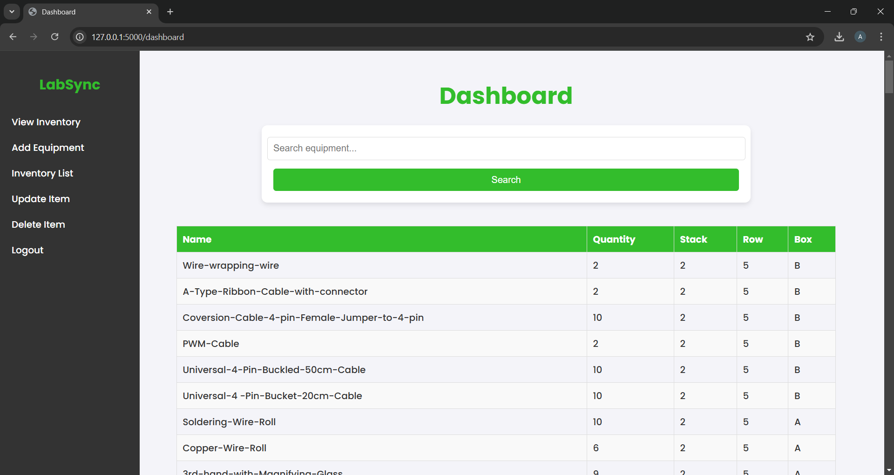
2. /dashboard
Central hub for managing and viewing inventory.
Displays a searchable, sortable, and paginated table of all inventory items.
Fetches items from the database, supports search queries, and orders results by most recently added.

Slide 6
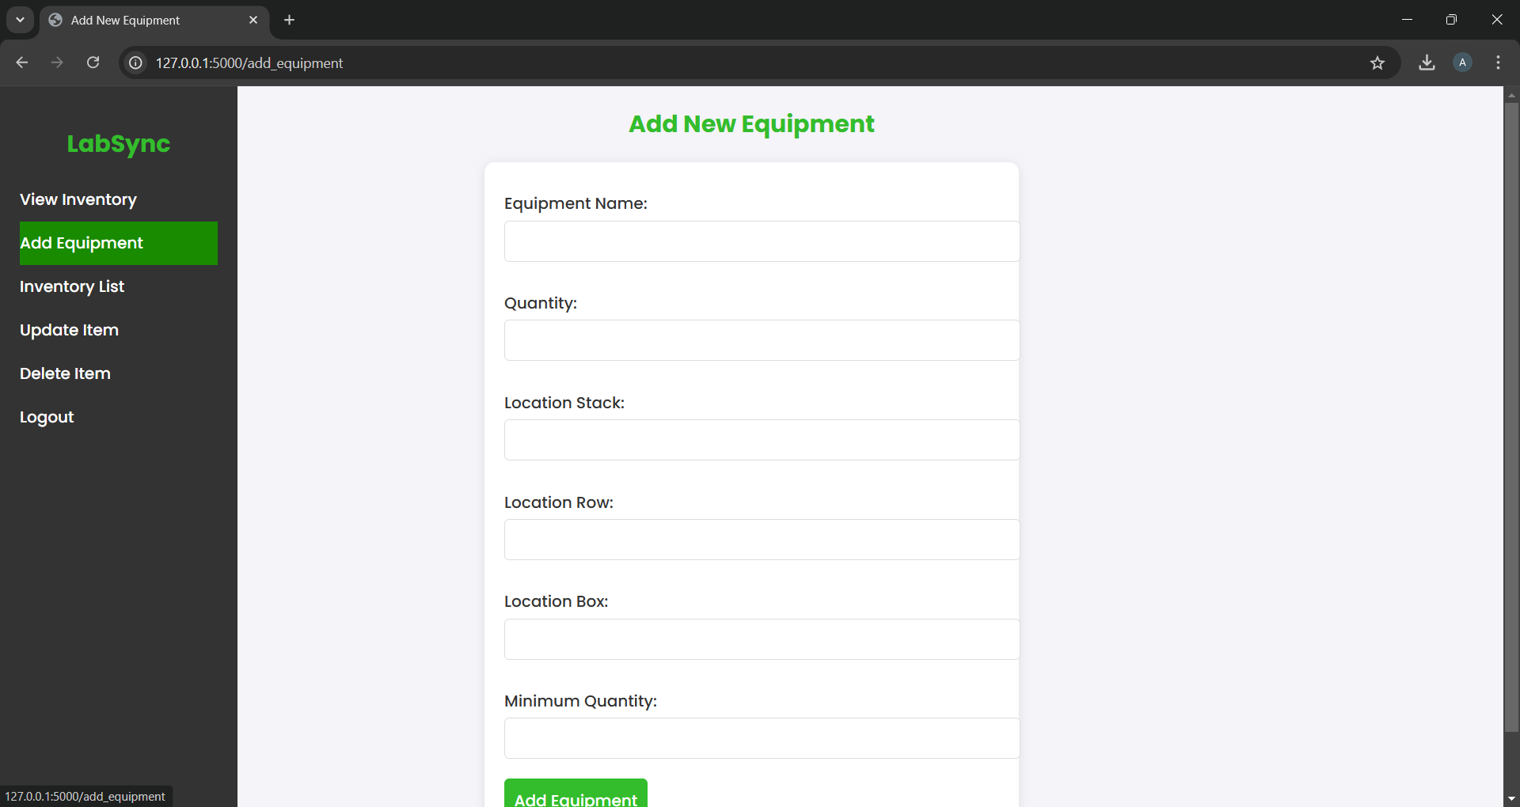
3. /add_equipment
Add new inventory items.
Provides a form for adding items with fields like name, quantity, location, and minimum quantity.
Inserts the item into the database and flashes a success message.

Slide 7
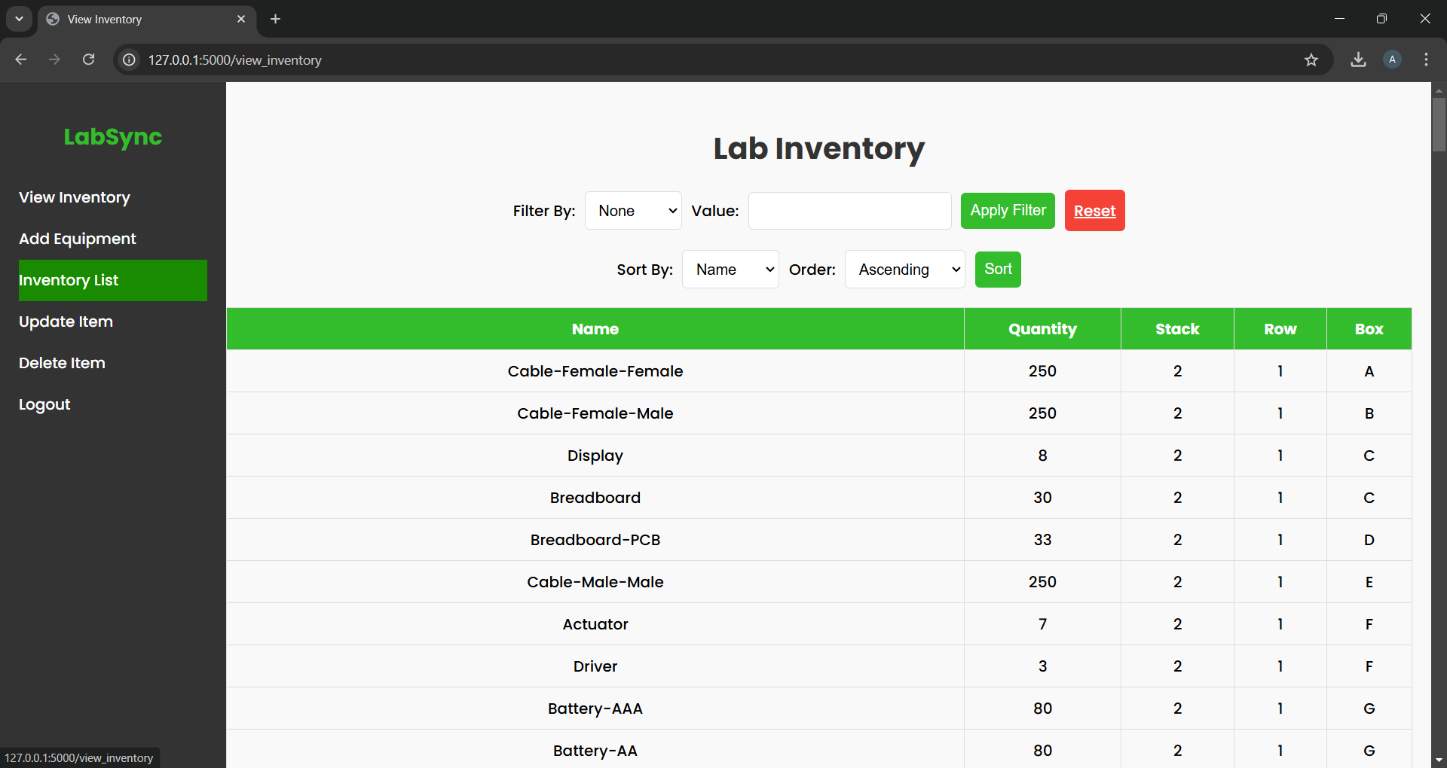
4. /view_inventory
View and filter inventory items.
Allows filtering and sorting by attributes like name, quantity, or location.
Dynamically fetches and displays filtered/sorted results.

Slide 8
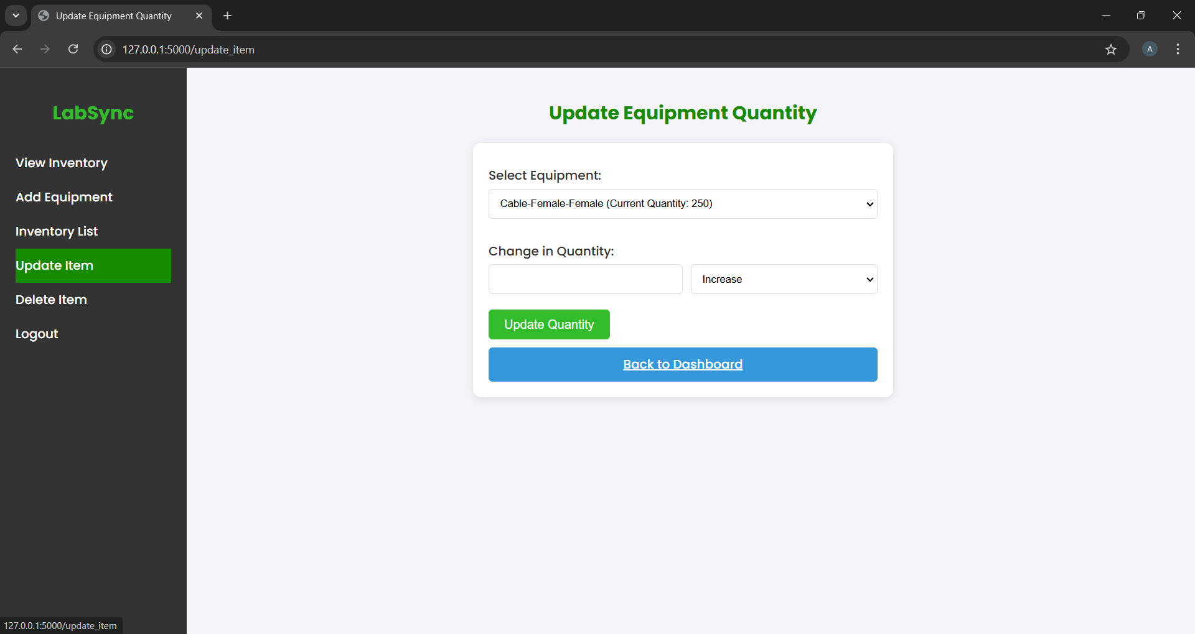
5. /update_item
Update the quantity of existing items.
Supports increasing or decreasing item quantities, with warnings for low stock
Updates item quantities in the database and flashes relevant messages.

Slide 9
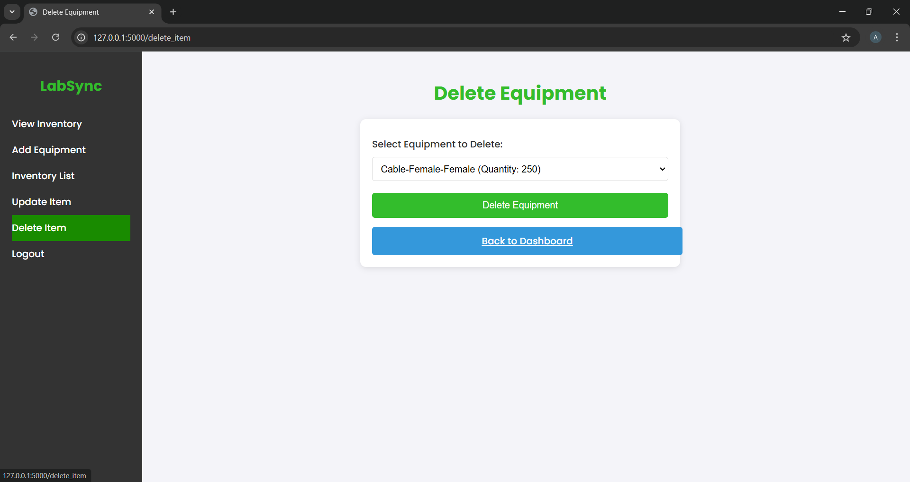
5. /delete_item
Delete inventory items.
Allows users to select and remove items from the database.
Deletes the selected item and flashes a success message.

Slide 10
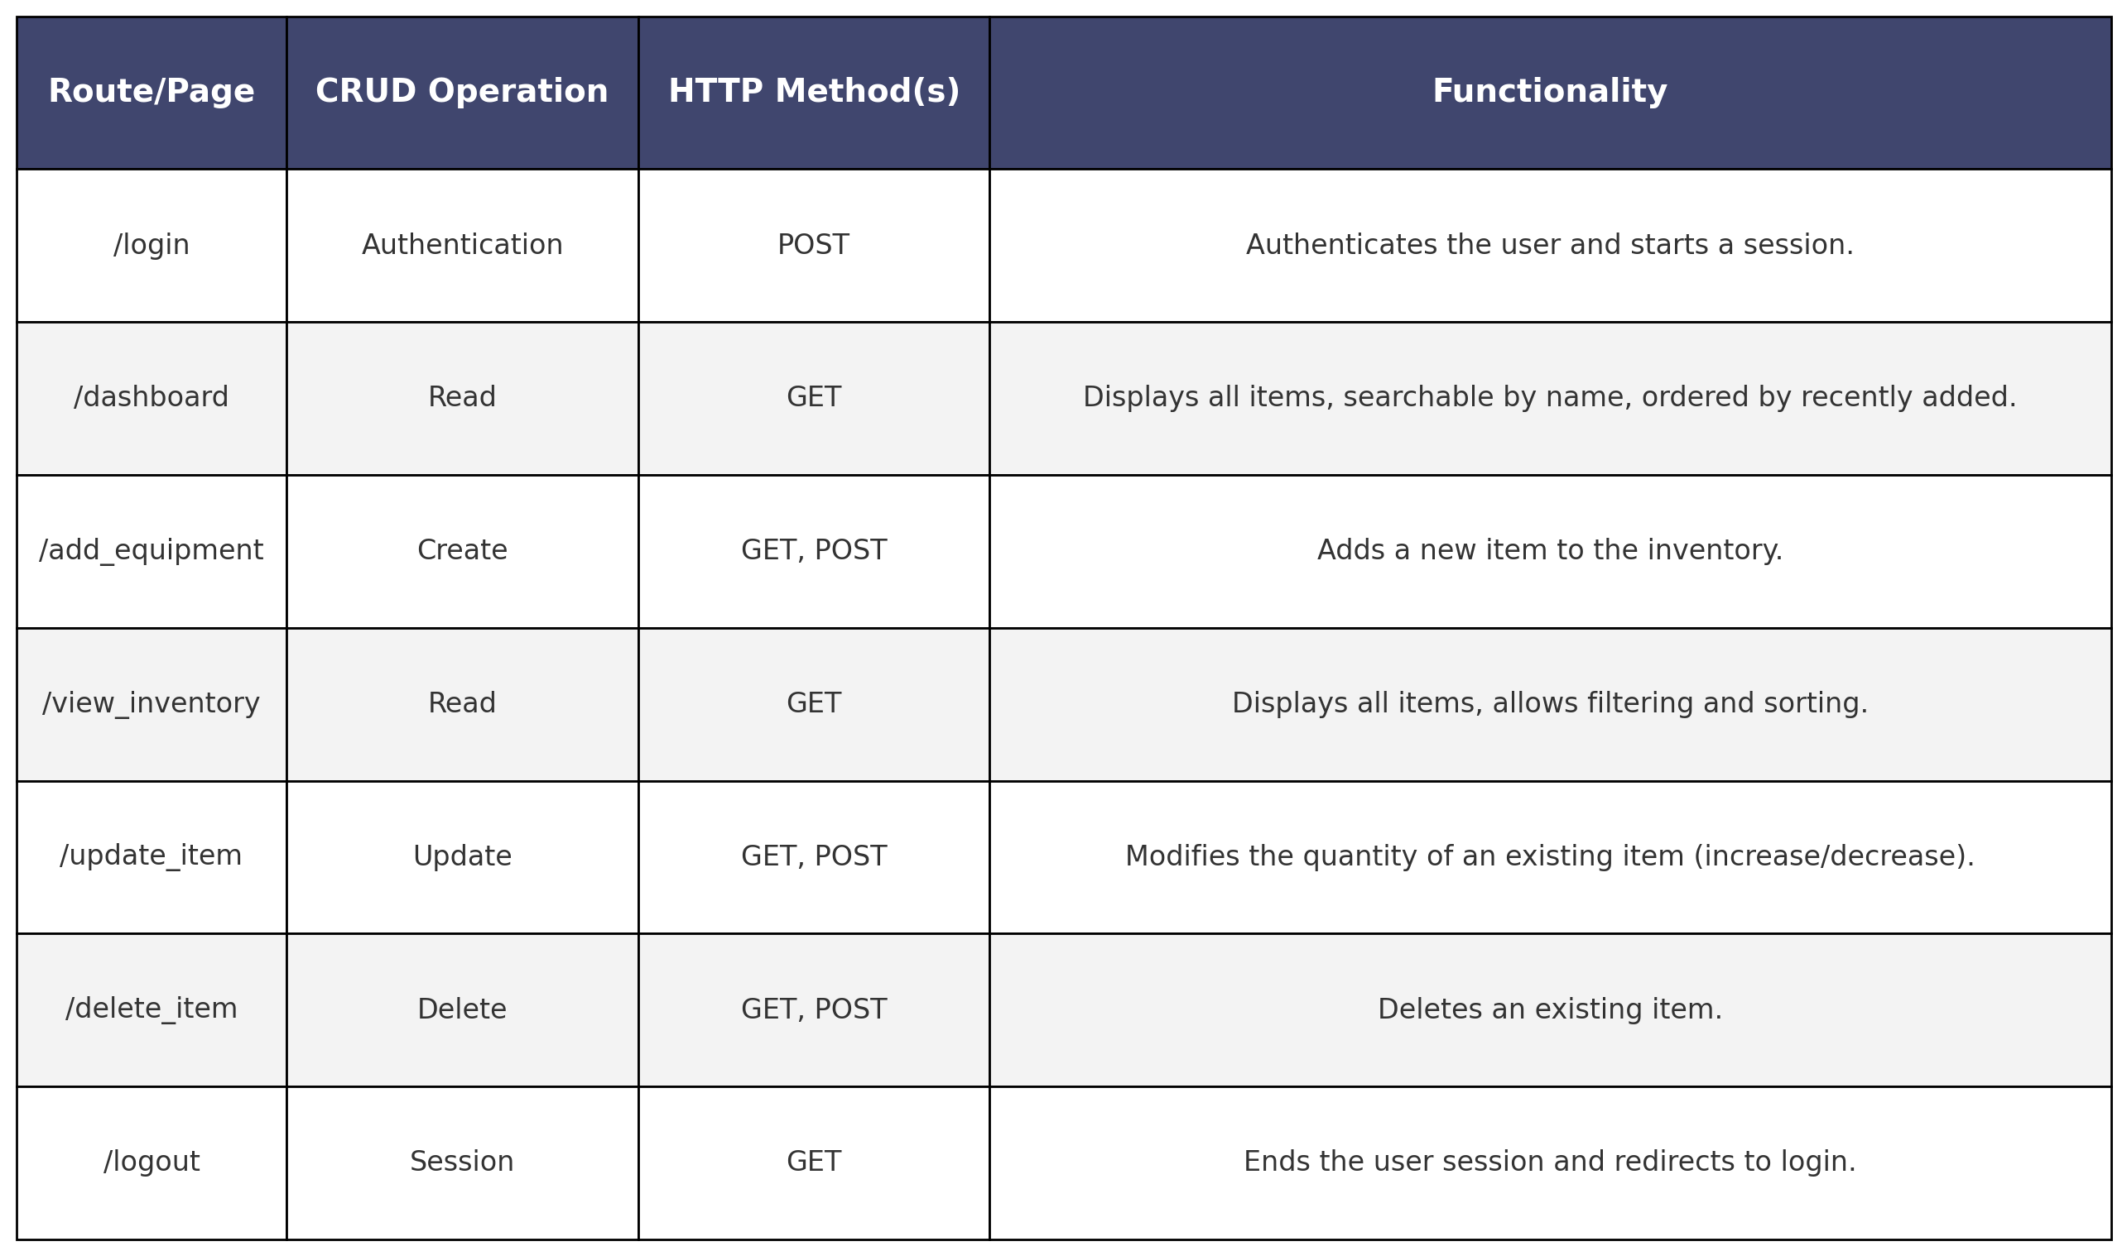
CRUD Summary

Slide 11

Next Steps
Remaining Tasks:
Refine frontend design for a cleaner and more intuitive UI.
Package the application in a Docker container.
Deploy to the university server for production use.
Future Enhancements:
Add a feature to upload an image of an equipment item, identify its name, and check if it exists in the inventory.
Integrate the system with e-commerce websites to suggest purchase options for items with low stock.

Slide 12

Questions .. ?

